Slide 1
higher Design & Manufacture
Product Life Cycle

Slide 2
Learning intentions & success criteria
Learning Intentions
Introduction to product lifecycle
Success Criteria
Describe and explain the different stages of product lifecycle.
Understand the meaning of planned obsolescence.

Slide 3
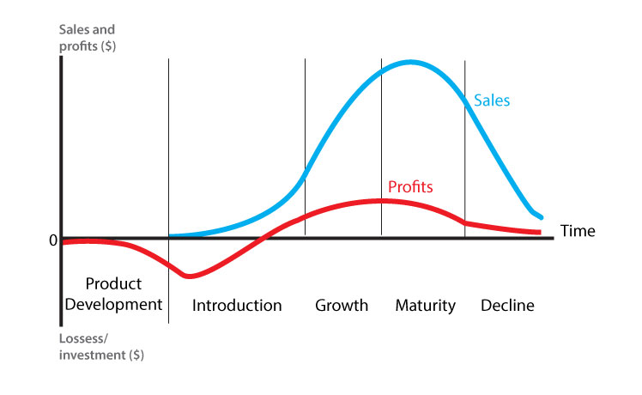
Product lifecycle
Product Lifecycle covers the following areas:

Slide 4
PRODUCT DEVELOPMENT
Product Development
Initial concept development.
High Research and Development Costs (R&D).
No sales at this stage.
The aim is to complete this phase quickly.

Slide 5
introduction
Sales start
Big push on advertising
Product Endorsement
Costs increase due to ramp up of production
Costs increase due to Marketing
Setup sales network

Slide 6
growth
High volume of sales
Reduced costs in R&D for this product
May have a niche market
Profit is generated

Slide 7
maturity
Sales begin to flatten and then drop off due to the product reaching end of life
Impact of newer products from competitors
Changes in technology outdate the product

Slide 8
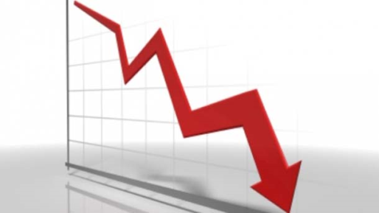
decline
Sales are dropping off sharply due to the end of the product life.
Demand has reduced significantly
Profit remains as no investment costs
No support in place to fix broken products

Slide 9
Maturity & DEcline
During the Maturity and Decline stages, how can we maximise our profit?
How can we ensure we are not left with excess stock and unwanted materials?

Slide 10
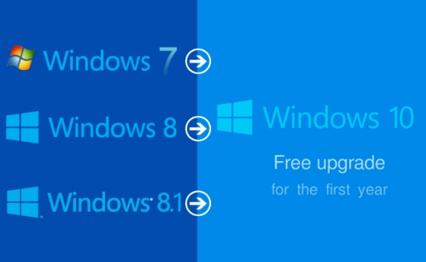
Maximise sales
To maximise sales:
Special offers (discount codes etc)
BOGOF (buy one get one free)
Upgrades
Change of packaging/colour (rebranding)
New accessories

Slide 11
Extending product lifetime
All of these techniques will help extend the sales of the product.
In doing so, it will use up any materials/components that have already been manufactured. This will improve long term profit.
What manufacturing product system would eliminate or at least reduce exposure to a loss on left over products/materials….?
Productions systems and planned obsolescence! (these will be covered in more depth later on).

Slide 12
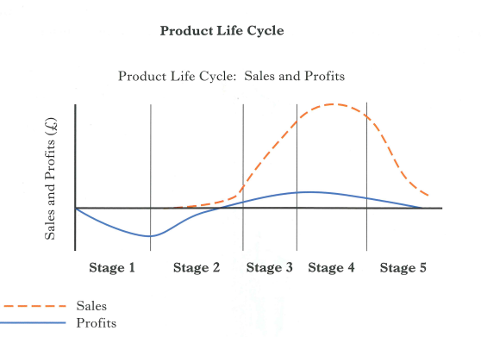
task
This is a typical question that is asking you to EXPLAIN the stages of the graph.
When it says EXPLAIN you must provide an answer that is structured and
written in sentences. You CANNOT provide ONE WORD answers.

Slide 13
answer
Stage 2 of the chart shows the initial sales starting to rise. As the sales increase, the costs of developing and marketing the new product are offset and the product starts to move into profit.
Stage 3 of the chart shows the product becoming more popular and sales increase quickly. The larger volume of sales means the profit increases as well.
Stage 4 of the chart shows the product reaching maturity as the sales increase to a peak and then start to drop off. Profit also reaches a peak and then also falls as sales decrease.
Stage 5 shows the product in decline as the sales are now falling and as sales fall profit starts to drop off more significantly than before.

Slide 14
obsolescence
By now we should be able to look at products and relate the terms PLANNED OBSOLESCENCE and PERCEIVED OBSOLESCENCE to them.
We may not see an exam question that specifically says “What is Obsolescence?” you should introduce your new found knowledge into questions that relate to;
Lifecyle
JIT (Just in Time production)
Sustainability
Circular Economy (make, use, dispose)
6 R’s (Reduce, Rethink, Refuse, Recycle, Reuse, Repair)

Slide 15
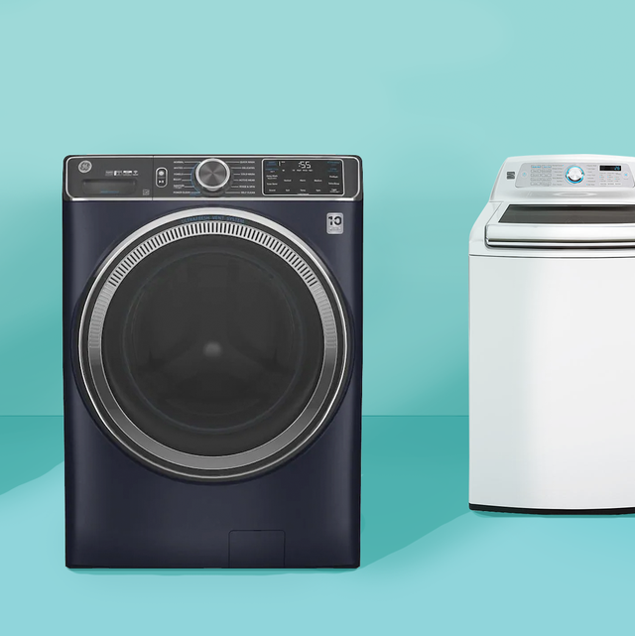
Planned obsolescence
Planned obsolescence is when a product is deliberately designed to have a specific life span. This is usually a shortened life span.
The product is designed to last long enough to develop a customer’s lasting need.
The product is also designed to convince the customer that the product is a quality product, even though it eventually needs replacing.
In this way, when the product fails, the customer will want to buy another, up to date version.

Slide 16
example
Take for example a washing machine. Planned obsolescence means that the washing machine (seen opposite) is designed to last about two years, before it breaks down outside the guarantee time. Most of the components / parts have been manufactured from quality materials with the exception of some vital parts. Two years after purchase, the washing machine will only need minor inexpensive repairs. However, between 4 to 5 years the vitals parts begin to wear out and a replacement machine is required.
For planned obsolescence to work, the customer must feel that they have had value for money. Furthermore, they must have enough confidence in the manufacturer or company, to replace the original washing machine with the modern equivalent machine, from the same manufacturer.

Slide 17
Planned obsolescence
Most laptops will last you approx 3-5 years.
Most washing machines will approx. 11 years.
If all our products were to last a lifetime, how are companies going to make money?
Depends on the product as to how long a company wants it to last.
Examples could be:
T.V. typically 5 to 15 years
Car approx. 12 years (or 200k miles)

Slide 18
Planned obsolescence
It can be achieved by;
Bringing in new models or features.
Limiting parts for repairs (this is called limited product support).
Refusing people access to the designs (no repair shops).

Slide 19
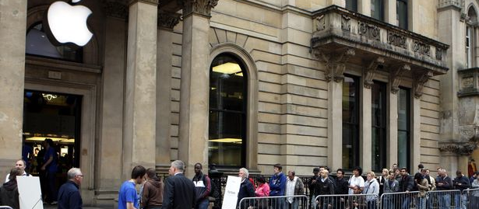
Perceived obsolescence
People will buy products because there is a newer one out, not because what they have is broken.
They will buy what their friends or neighbours have to give the impression of keeping in style, on trend, or wealthy.
Branding plays an important part of this. Even if products are near identical, some may choose the more expensive branded option to appear trendy/wealthy.

